Slide 1
Data Structures
26. Shortest Path Trees

Slide 2
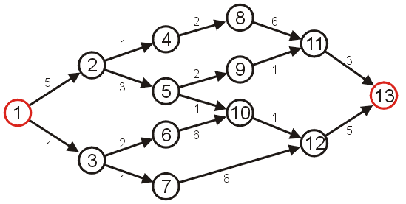
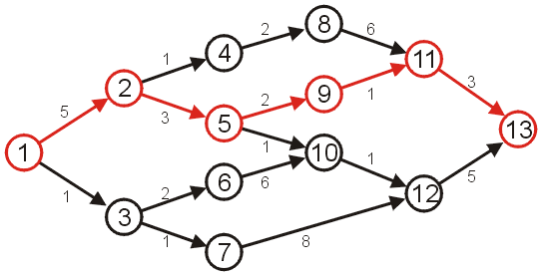
Shortest Path
Given a weighted graph
Problem is to find the shortest path between two given vertices
Length of a path in a weighted graph
Sum of the weights of each of the edges in that path
Example: Shortest path from vertex 1 to vertex 13
Other paths exists but they are longer

Slide 3
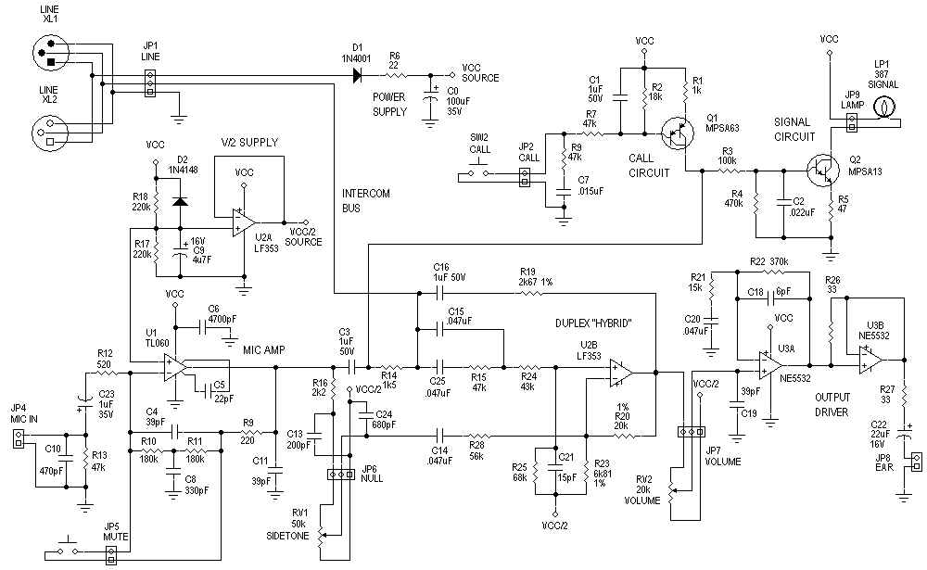
Application – Circuit Design
The time it takes for a change in input to affect an output depends on the shortest path

Slide 4
Application – Computer Networks
The Internet is a collection of interconnected computer networks
Information is passed through packets
Packets are passed from the source, through routers, to their destination
Routers are connected to either:
Individual computers, or
Other routers
These may be represented as graphs

Slide 5

Application – Computer Networks
A visualization of the graph of the routers and their various connections through a portion of the Internet
http://en.wikipedia.org/wiki/Internet

Slide 6
Application – Computer Networks
The path a packet takes depends on the IP address
Metrics for measuring the shortest path may include
Low latency (minimize time)
Minimum hop count (all edges have weight 1)

Slide 7
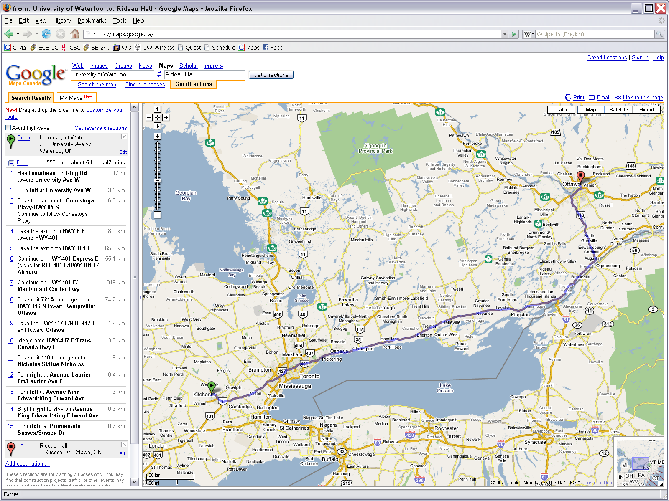
Application – Traffic
Find the shortest route between to points on a map
Shortest path, however, need not refer to distance...

Slide 8
Variants of Shortest Path
Given a graph G = (V, E)
Single-source shortest paths
Find shortest path from a given source vertex s to each vertex v ∈ V
Single-destination shortest paths
Find shortest path to a given destination vertex t from each vertex v
Single-pair shortest path
Find shortest path from u to v for given vertices u and v
All-pairs shortest-paths
Find shortest path from u to v for every pair of vertices u and v

Slide 9
Single Source Shortest Path

Slide 10
Dijkstra's Algorithm
Problem: From a given source vertex s∈V, find the shortest-paths and their weights w(s,v) for all v∈V
Idea of the Algorithm
Maintain a set S of vertices whose shortest-path distances from s are known
At each step add to S the vertex v∈ V–S whose distance estimate from s is minimal
Update the distance estimates of vertices adjacent to v

Slide 11
Dijkstra's Algorithm - Pseudocode
dist[s] = 0 // distance to source vertex is zero
p[s] = NULL for all v ∈ V–{s} dist[v] = ∞ // set all other distances to infinity S = ∅ //S, the set of visited vertices is initially empty Q = V //Q, the queue initially contains all vertices
while Q is not emppty //while the queue is not empty u = mindistance(Q) //select the element of Q with the min distance S = S∪{u} // add u to list of visited vertices for all v ∈ neighbors[u] if dist[v] > dist[u] + w(u,v) //if new shortest path found dist[v] = dist[u] + w(u,v) //set new value of shortest path
p[v] = u

Slide 12
Dijkstra’s Vs. Prim’s Algorithm
Dijkstra’s Algorithm
dist[s] = 0
p[s] = NULL for all v ∈ V–{s} dist[v] = ∞ S = ∅ Q = V while (Q not empty) u = mindistance(Q) S = S∪{u} for all v ∈ neighbors[u] && v∈V-S if dist[u] + w(u, v) < dist[v] dist[v] = dist[u] + w(u, v)
p[v] = u
Prim’s Algorithm
Q = V[G];
for each u ∈ Q
key[u] = ∞;
key[r] = 0;
p[r] = NULL;
while (Q not empty)
u = ExtractMin(Q);
for each v ∈ Adj[u]
if (v ∈ Q and w(u,v) < key[v])
p[v] = u;
key[v] = w(u,v);

Slide 13
Dijkstra's Algorithm – Example
2
Q:
A
B
C
D
E
B
D
10
0
∞
∞
∞
∞
A
1
8
4
7
9
3
C
E
2
Vertex | Distance | Parent
A | 0 | Ø
B | ∞ | Ø
C | ∞ | Ø
D | ∞ | Ø
E | ∞ | Ø
Initialization
S: {}

Slide 14
Dijkstra's Algorithm – Example
2
Q:
A
B
C
D
E
B
D
10
0
∞
∞
∞
∞
A
1
8
4
7
9
3
C
E
2
Vertex | Distance | Parent
A | 0 | Ø
B | ∞ | Ø
C | ∞ | Ø
D | ∞ | Ø
E | ∞ | Ø
A ← EXTRACT-MIN(Q)
S: {A}

Slide 15
Dijkstra's Algorithm – Example
2
Q:
A
B
C
D
E
B
D
10
0
∞
∞
∞
∞
1
8
10
3
∞
∞
A
7
4
9
3
C
E
2
Vertex | Distance | Parent
A | 0 | Ø
B | 10 | A
C | 3 | A
D | ∞ | Ø
E | ∞ | Ø
Update all neighbors of A
S: {A}

Slide 16
Dijkstra's Algorithm – Example
2
Q:
A
B
C
D
E
B
D
10
0
∞
∞
∞
∞
1
8
10
3
∞
∞
A
7
4
9
3
C
E
2
Vertex | Distance | Parent
A | 0 | Ø
B | 10 | A
C | 3 | A
D | ∞ | Ø
E | ∞ | Ø
C ← EXTRACT-MIN(Q)
S: {A, C}

Slide 17
Dijkstra's Algorithm – Example
2
Q:
A
B
C
D
E
B
D
10
0
∞
∞
∞
∞
1
8
10
3
∞
∞
A
7
4
9
7
11
5
3
C
E
2
Vertex | Distance | Parent
A | 0 | Ø
B | 7 | C
C | 3 | A
D | 11 | C
E | 5 | C
Update all neighbors of C
S: {A, C}

Slide 18
Dijkstra's Algorithm – Example
2
Q:
A
B
C
D
E
B
D
10
0
∞
∞
∞
∞
1
8
10
3
∞
∞
A
7
4
9
7
11
5
3
C
E
2
Vertex | Distance | Parent
A | 0 | Ø
B | 7 | C
C | 3 | A
D | 11 | C
E | 5 | C
E ← EXTRACT-MIN(Q)
S: {A, C, E}

Slide 19
Dijkstra's Algorithm – Example
2
Q:
A
B
C
D
E
B
D
10
0
∞
∞
∞
∞
1
8
10
3
∞
∞
A
7
4
9
7
11
5
3
7
11
C
E
2
Vertex | Distance | Parent
A | 0 | Ø
B | 7 | C
C | 3 | A
D | 11 | C
E | 5 | C
Update all neighbors of E
S: {A, C, E}

Slide 20
Dijkstra's Algorithm – Example
2
Q:
A
B
C
D
E
B
D
10
0
∞
∞
∞
∞
1
8
10
3
∞
∞
A
7
4
9
7
11
5
3
7
11
C
E
2
Vertex | Distance | Parent
A | 0 | Ø
B | 7 | C
C | 3 | A
D | 11 | C
E | 5 | C
B ← EXTRACT-MIN(Q)
S: {A, C, E, B}

Slide 21
Dijkstra's Algorithm – Example
2
Q:
A
B
C
D
E
B
D
10
0
∞
∞
∞
∞
1
8
10
3
∞
∞
A
7
4
9
7
11
5
3
7
11
C
E
9
2
Vertex | Distance | Parent
A | 0 | Ø
B | 7 | C
C | 3 | A
D | 9 | B
E | 5 | C
Update all neighbors of B
S: {A, C, E, B}

Slide 22
Dijkstra's Algorithm – Example
2
Q:
A
B
C
D
E
B
D
10
0
∞
∞
∞
∞
1
8
10
3
∞
∞
A
7
4
9
7
11
5
3
7
11
C
E
9
2
Vertex | Distance | Parent
A | 0 | Ø
B | 7 | C
C | 3 | A
D | 9 | B
E | 5 | C
D ← EXTRACT-MIN(Q)
S: {A, C, E, B, D}

Slide 23
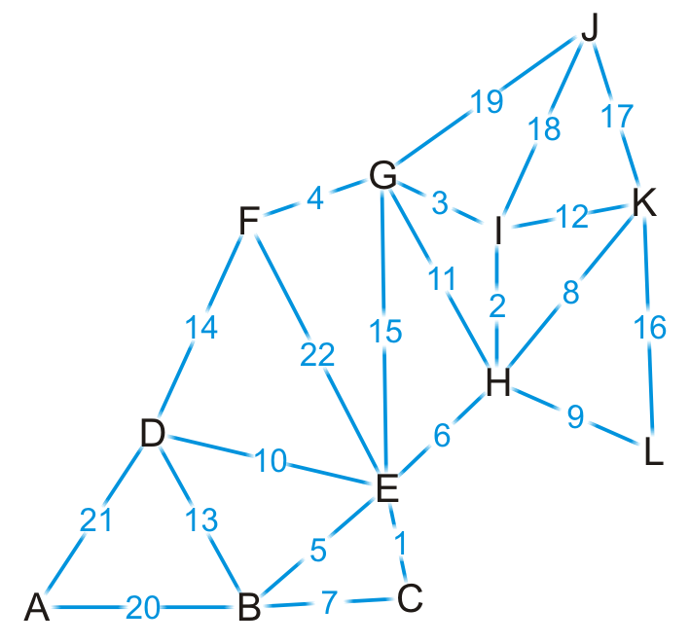
Dijkstra's Algorithm – Example
Find the shortest path from K to every other vertex

Slide 24
Dijkstra's Algorithm – Example
We visit vertex K
Vertex | S | Distance | Parent
A | F | ∞ | Ø
B | F | ∞ | Ø
C | F | ∞ | Ø
D | F | ∞ | Ø
E | F | ∞ | Ø
F | F | ∞ | Ø
G | F | ∞ | Ø
H | F | ∞ | Ø
I | F | ∞ | Ø
J | F | ∞ | Ø
K | T | 0 | Ø
L | F | ∞ | Ø

Slide 25
Dijkstra's Algorithm – Example
Vertex K has four neighbors: H, I, J and L
Vertex | S | Distance | Parent
A | F | ∞ | Ø
B | F | ∞ | Ø
C | F | ∞ | Ø
D | F | ∞ | Ø
E | F | ∞ | Ø
F | F | ∞ | Ø
G | F | ∞ | Ø
H | F | ∞ | Ø
I | F | ∞ | Ø
J | F | ∞ | Ø
K | T | 0 | Ø
L | F | ∞ | Ø

Slide 26
Dijkstra's Algorithm – Example
We have now found at least one path to each of these vertices
Vertex | S | Distance | Parent
A | F | ∞ | Ø
B | F | ∞ | Ø
C | F | ∞ | Ø
D | F | ∞ | Ø
E | F | ∞ | Ø
F | F | ∞ | Ø
G | F | ∞ | Ø
H | F | 8 | K
I | F | 12 | K
J | F | 17 | K
K | T | 0 | Ø
L | F | 16 | K

Slide 27
Dijkstra's Algorithm – Example
We’re finished with vertex K
To which vertex are we now guaranteed we have the shortest path?
mindistance(Q)
Vertex | S | Distance | Parent
A | F | ∞ | Ø
B | F | ∞ | Ø
C | F | ∞ | Ø
D | F | ∞ | Ø
E | F | ∞ | Ø
F | F | ∞ | Ø
G | F | ∞ | Ø
H | F | 8 | K
I | F | 12 | K
J | F | 17 | K
K | T | 0 | Ø
L | F | 16 | K

Slide 28
Dijkstra's Algorithm – Example
We visit vertex H: the shortest path is (K, H) of length 8
Vertex H has four unvisited neighbors: E, G, I, L
Vertex | S | Distance | Parent
A | F | ∞ | Ø
B | F | ∞ | Ø
C | F | ∞ | Ø
D | F | ∞ | Ø
E | F | ∞ | Ø
F | F | ∞ | Ø
G | F | ∞ | Ø
H | T | 8 | K
I | F | 12 | K
J | F | 17 | K
K | T | 0 | Ø
L | F | 16 | K

Slide 29
Dijkstra's Algorithm – Example
Consider these paths:
(K, H, E) of length 8 + 6 = 14 (K, H, G) of length 8 + 11 = 19
(K, H, I) of length 8 + 2 = 10 (K, H, L) of length 8 + 9 = 17
Which of these are shorter than any known path?
Vertex | S | Distance | Parent
A | F | ∞ | Ø
B | F | ∞ | Ø
C | F | ∞ | Ø
D | F | ∞ | Ø
E | F | ∞ | Ø
F | F | ∞ | Ø
G | F | ∞ | Ø
H | T | 8 | K
I | F | 12 | K
J | F | 17 | K
K | T | 0 | Ø
L | F | 16 | K

Slide 30
Dijkstra's Algorithm – Example
We already have a shorter path (K, L), but we update the others
Vertex | S | Distance | Parent
A | F | ∞ | Ø
B | F | ∞ | Ø
C | F | ∞ | Ø
D | F | ∞ | Ø
E | F | 14 | H
F | F | ∞ | Ø
G | F | 19 | H
H | T | 8 | K
I | F | 10 | H
J | F | 17 | K
K | T | 0 | Ø
L | F | 16 | K

Slide 31
Dijkstra's Algorithm – Example
We are finished with vertex H
Which vertex do we visit next?
Vertex | S | Distance | Parent
A | F | ∞ | Ø
B | F | ∞ | Ø
C | F | ∞ | Ø
D | F | ∞ | Ø
E | F | 14 | H
F | F | ∞ | Ø
G | F | 19 | H
H | T | 8 | K
I | F | 10 | H
J | F | 17 | K
K | T | 0 | Ø
L | F | 16 | K

Slide 32
Dijkstra's Algorithm – Example
The path (K, H, I) is the shortest path from K to I of length 10
Vertex I has two unvisited neighbors: G and J
Vertex | S | Distance | Parent
A | F | ∞ | Ø
B | F | ∞ | Ø
C | F | ∞ | Ø
D | F | ∞ | Ø
E | F | 14 | H
F | F | ∞ | Ø
G | F | 19 | H
H | T | 8 | K
I | T | 10 | H
J | F | 17 | K
K | T | 0 | Ø
L | F | 16 | K

Slide 33
Dijkstra's Algorithm – Example
Consider these paths:
(K, H, I, G) of length 10 + 3 = 13
(K, H, I, J) of length 10 + 18 = 28
Vertex | S | Distance | Parent
A | F | ∞ | Ø
B | F | ∞ | Ø
C | F | ∞ | Ø
D | F | ∞ | Ø
E | F | 14 | H
F | F | ∞ | Ø
G | F | 19 | H
H | T | 8 | K
I | T | 10 | H
J | F | 17 | K
K | T | 0 | Ø
L | F | 16 | K

Slide 34
Dijkstra's Algorithm – Example
We have discovered a shorter path to vertex G, but (K, J) is still the shortest known path to vertex J
Vertex | S | Distance | Parent
A | F | ∞ | Ø
B | F | ∞ | Ø
C | F | ∞ | Ø
D | F | ∞ | Ø
E | F | 14 | H
F | F | ∞ | Ø
G | F | 13 | I
H | T | 8 | K
I | T | 10 | H
J | F | 17 | K
K | T | 0 | Ø
L | F | 16 | K

Slide 35
Dijkstra's Algorithm – Example
Which vertex can we visit next?
Vertex | S | Distance | Parent
A | F | ∞ | Ø
B | F | ∞ | Ø
C | F | ∞ | Ø
D | F | ∞ | Ø
E | F | 14 | H
F | F | ∞ | Ø
G | F | 13 | I
H | T | 8 | K
I | T | 10 | H
J | F | 17 | K
K | T | 0 | Ø
L | F | 16 | K

Slide 36
Dijkstra's Algorithm – Example
The path (K, H, I, G) is the shortest path from K to G of length 13
Vertex G has three unvisited neighbors: E, F and J
Vertex | S | Distance | Parent
A | F | ∞ | Ø
B | F | ∞ | Ø
C | F | ∞ | Ø
D | F | ∞ | Ø
E | F | 14 | H
F | F | ∞ | Ø
G | T | 13 | I
H | T | 8 | K
I | T | 10 | H
J | F | 17 | K
K | T | 0 | Ø
L | F | 16 | K

Slide 37
Dijkstra's Algorithm – Example
Consider these paths:
(K, H, I, G, E) of length 13 + 15 = 28
(K, H, I, G, F) of length 13 + 4 = 17
(K, H, I, G, J) of length 13 + 19 = 32
Which do we update?
Vertex | S | Distance | Parent
A | F | ∞ | Ø
B | F | ∞ | Ø
C | F | ∞ | Ø
D | F | ∞ | Ø
E | F | 14 | H
F | F | ∞ | Ø
G | T | 13 | I
H | T | 8 | K
I | T | 10 | H
J | F | 17 | K
K | T | 0 | Ø
L | F | 16 | K

Slide 38
Dijkstra's Algorithm – Example
We have now found a path to vertex F
Vertex | S | Distance | Parent
A | F | ∞ | Ø
B | F | ∞ | Ø
C | F | ∞ | Ø
D | F | ∞ | Ø
E | F | 14 | H
F | F | 17 | G
G | T | 13 | I
H | T | 8 | K
I | T | 10 | H
J | F | 17 | K
K | T | 0 | Ø
L | F | 16 | K

Slide 39
Dijkstra's Algorithm – Example
Where do we visit next?
Vertex | S | Distance | Parent
A | F | ∞ | Ø
B | F | ∞ | Ø
C | F | ∞ | Ø
D | F | ∞ | Ø
E | F | 14 | H
F | F | 17 | G
G | T | 13 | I
H | T | 8 | K
I | T | 10 | H
J | F | 17 | K
K | T | 0 | Ø
L | F | 16 | K

Slide 40
Dijkstra's Algorithm – Example
The path (K, H, E) is the shortest path from K to E of length 14
Vertex G has four unvisited neighbors: B, C, D and F
Vertex | S | Distance | Parent
A | F | ∞ | Ø
B | F | ∞ | Ø
C | F | ∞ | Ø
D | F | ∞ | Ø
E | T | 14 | H
F | F | 17 | G
G | T | 13 | I
H | T | 8 | K
I | T | 10 | H
J | F | 17 | K
K | T | 0 | Ø
L | F | 16 | K

Slide 41
Dijkstra's Algorithm – Example
The path (K, H, E) is the shortest path from K to E of length 14
Vertex G has four unvisited neighbors: B, C, D and F
Vertex | S | Distance | Parent
A | F | ∞ | Ø
B | F | ∞ | Ø
C | F | ∞ | Ø
D | F | ∞ | Ø
E | T | 14 | H
F | F | 17 | G
G | T | 13 | I
H | T | 8 | K
I | T | 10 | H
J | F | 17 | K
K | T | 0 | Ø
L | F | 16 | K

Slide 42
Dijkstra's Algorithm – Example
Consider these paths:
(K, H, E, B) of length 14 + 5 = 19
(K, H, E, C) of length 14 + 1 = 15
(K, H, E, D) of length 14 + 10 = 24
(K, H, E, F) of length 14 + 22 = 36
Vertex | S | Distance | Parent
A | F | ∞ | Ø
B | F | ∞ | Ø
C | F | ∞ | Ø
D | F | ∞ | Ø
E | T | 14 | H
F | F | 17 | G
G | T | 13 | I
H | T | 8 | K
I | T | 10 | H
J | F | 17 | K
K | T | 0 | Ø
L | F | 16 | K

Slide 43
Dijkstra's Algorithm – Example
We’ve discovered paths to vertices B, C, D
Vertex | S | Distance | Parent
A | F | ∞ | Ø
B | F | 19 | E
C | F | 15 | E
D | F | 24 | E
E | T | 14 | H
F | F | 17 | G
G | T | 13 | I
H | T | 8 | K
I | T | 10 | H
J | F | 17 | K
K | T | 0 | Ø
L | F | 16 | K

Slide 44
Dijkstra's Algorithm – Example
Which vertex is next?
Vertex | S | Distance | Parent
A | F | ∞ | Ø
B | F | 19 | E
C | F | 15 | E
D | F | 24 | E
E | T | 14 | H
F | F | 17 | G
G | T | 13 | I
H | T | 8 | K
I | T | 10 | H
J | F | 17 | K
K | T | 0 | Ø
L | F | 16 | K

Slide 45
Dijkstra's Algorithm – Example
We’ve found that the path (K, H, E, C) of length 15 is the shortest path from K to C
Vertex C has one unvisited neighbor, B
Vertex | S | Distance | Parent
A | F | ∞ | Ø
B | F | 19 | E
C | T | 15 | E
D | F | 24 | E
E | T | 14 | H
F | F | 17 | G
G | T | 13 | I
H | T | 8 | K
I | T | 10 | H
J | F | 17 | K
K | T | 0 | Ø
L | F | 16 | K

Slide 46
Dijkstra's Algorithm – Example
The path (K, H, E, C, B) is of length 15 + 7 = 22
We have already discovered a shorter path through vertex E
Vertex | S | Distance | Parent
A | F | ∞ | Ø
B | F | 19 | E
C | T | 15 | E
D | F | 24 | E
E | T | 14 | H
F | F | 17 | G
G | T | 13 | I
H | T | 8 | K
I | T | 10 | H
J | F | 17 | K
K | T | 0 | Ø
L | F | 16 | K

Slide 47
Dijkstra's Algorithm – Example
Where to next?
Vertex | S | Distance | Parent
A | F | ∞ | Ø
B | F | 19 | E
C | T | 15 | E
D | F | 24 | E
E | T | 14 | H
F | F | 17 | G
G | T | 13 | I
H | T | 8 | K
I | T | 10 | H
J | F | 17 | K
K | T | 0 | Ø
L | F | 16 | K

Slide 48
Dijkstra's Algorithm – Example
We now know that (K, L) is the shortest path between these two points
Vertex L has no unvisited neighbors
Vertex | S | Distance | Parent
A | F | ∞ | Ø
B | F | 19 | E
C | T | 15 | E
D | F | 24 | E
E | T | 14 | H
F | F | 17 | G
G | T | 13 | I
H | T | 8 | K
I | T | 10 | H
J | F | 17 | K
K | T | 0 | Ø
L | T | 16 | K

Slide 49
Dijkstra's Algorithm – Example
Where to next?
Does it matter if we visit vertex F first or vertex J first?
Vertex | S | Distance | Parent
A | F | ∞ | Ø
B | F | 19 | E
C | T | 15 | E
D | F | 24 | E
E | T | 14 | H
F | F | 17 | G
G | T | 13 | I
H | T | 8 | K
I | T | 10 | H
J | F | 17 | K
K | T | 0 | Ø
L | T | 16 | K

Slide 50
Dijkstra's Algorithm – Example
Let’s visit vertex F first
It has one unvisited neighbor, vertex D
Vertex | S | Distance | Parent
A | F | ∞ | Ø
B | F | 19 | E
C | T | 15 | E
D | F | 24 | E
E | T | 14 | H
F | T | 17 | G
G | T | 13 | I
H | T | 8 | K
I | T | 10 | H
J | F | 17 | K
K | T | 0 | Ø
L | T | 16 | K

Slide 51
Dijkstra's Algorithm – Example
The path (K, H, I, G, F, D) is of length 17 + 14 = 31
This is longer than the path we’ve already discovered
Vertex | S | Distance | Parent
A | F | ∞ | Ø
B | F | 19 | E
C | T | 15 | E
D | F | 24 | E
E | T | 14 | H
F | T | 17 | G
G | T | 13 | I
H | T | 8 | K
I | T | 10 | H
J | F | 17 | K
K | T | 0 | Ø
L | T | 16 | K

Slide 52
Dijkstra's Algorithm – Example
Now we visit vertex J
It has no unvisited neighbors
Vertex | S | Distance | Parent
A | F | ∞ | Ø
B | F | 19 | E
C | T | 15 | E
D | F | 24 | E
E | T | 14 | H
F | T | 17 | G
G | T | 13 | I
H | T | 8 | K
I | T | 10 | H
J | T | 17 | K
K | T | 0 | Ø
L | T | 16 | K

Slide 53
Dijkstra's Algorithm – Example
Next we visit vertex B, which has two unvisited neighbors:
(K, H, E, B, A) of length 19 + 20 = 39
(K, H, E, B, D) of length 19 + 13 = 32
We update the path length to A
Vertex | S | Distance | Parent
A | F | 39 | B
B | T | 19 | E
C | T | 15 | E
D | F | 24 | E
E | T | 14 | H
F | T | 17 | G
G | T | 13 | I
H | T | 8 | K
I | T | 10 | H
J | T | 17 | K
K | T | 0 | Ø
L | T | 16 | K

Slide 54
Dijkstra's Algorithm – Example
Next we visit vertex D
The path (K, H, E, D, A) is of length 24 + 21 = 45
We don’t update A
Vertex | S | Distance | Parent
A | F | 39 | B
B | T | 19 | E
C | T | 15 | E
D | T | 24 | E
E | T | 14 | H
F | T | 17 | G
G | T | 13 | I
H | T | 8 | K
I | T | 10 | H
J | T | 17 | K
K | T | 0 | Ø
L | T | 16 | K

Slide 55
Dijkstra's Algorithm – Example
Finally, we visit vertex A
It has no unvisited neighbors and there are no unvisited vertices left
We are done
Vertex | S | Distance | Parent
A | T | 39 | B
B | T | 19 | E
C | T | 15 | E
D | T | 24 | E
E | T | 14 | H
F | T | 17 | G
G | T | 13 | I
H | T | 8 | K
I | T | 10 | H
J | T | 17 | K
K | T | 0 | Ø
L | T | 16 | K

Slide 56
Dijkstra's Algorithm – Example
Thus, we have found the shortest path from vertex K to each of the other vertices
Vertex | S | Distance | Parent
A | T | 39 | B
B | T | 19 | E
C | T | 15 | E
D | T | 24 | E
E | T | 14 | H
F | T | 17 | G
G | T | 13 | I
H | T | 8 | K
I | T | 10 | H
J | T | 17 | K
K | T | 0 | Ø
L | T | 16 | K

Slide 57
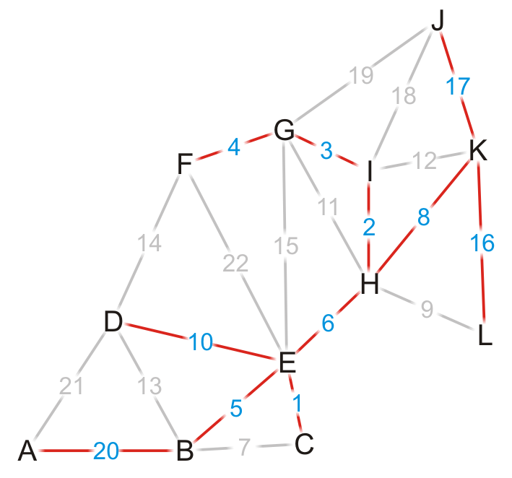
Dijkstra's Algorithm – Example
Using the previous pointers, we can reconstruct the paths
Vertex | S | Distance | Parent
A | T | 39 | B
B | T | 19 | E
C | T | 15 | E
D | T | 24 | E
E | T | 14 | H
F | T | 17 | G
G | T | 13 | I
H | T | 8 | K
I | T | 10 | H
J | T | 17 | K
K | T | 0 | Ø
L | T | 16 | K

Slide 58
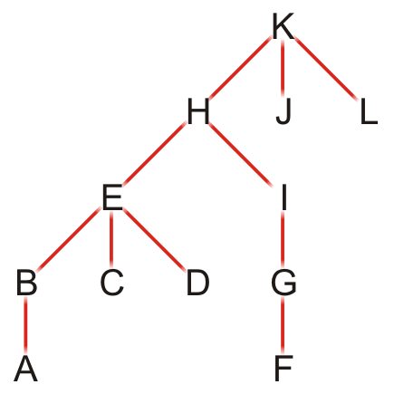
Dijkstra's Algorithm – Example
The table defines a rooted parental tree
The source vertex K is at the root
The previous pointer is the parent of the vertex in the tree
Vertex | Previous
A | B
B | E
C | E
D | E
E | H
F | G
G | I
H | K
I | H
J | K
K | Ø
L | K

Slide 59
Comments on Dijkstra’s Algorithm
If at some point, all unvisited vertices have a distance ∞?
This means that the graph is unconnected
We have found the shortest paths to all vertices in the connected subgraph containing the source vertex
To find the shortest path between vertices v_{j} and v_{k}?
Apply the same algorithm, but stop when visiting vertex v_{k}
Does the algorithm change if graph is directed?
No

Slide 60
Negative Edges
Dijkstra’s algorithm is based on the greedy method
It adds vertices by increasing distance
If a node with a negative incident edge is visited late
It could mess up distances for vertices already in the set S
0
8
A
4
6
7
5
4
B
7
C
1
D
5
0
-8
9
2
E
F
5
S: {A, C, E, D}
C’s true distance is 1, but it is already in the set S with dist(C)=5!

Slide 61
All Pairs Shortest Path

Slide 62
Dynamic Programming
Algorithm design method that can be used when the solution to a problem may be viewed as the result of a sequence of decisions
Example: How to find shortest path from S to T?

Slide 63
Dynamic Programming – Backward Reasoning
d(S, T) = min{1+d(A, T), 2+d(B, T), 5+d(C, T)}
d(A,T) = min{4+d(D,T), 11+d(E,T)} = min{4+18, 11+13} = 22

Slide 64
Dynamic Programming – Backward Reasoning
d(B, T) = min{9+d(D, T), 5+d(E, T), 16+d(F, T)}
= min{9+18, 5+13, 16+2} = 18
d(C, T) = min{ 2+d(F, T) } = 2+2 = 4
d(S, T) = min{1+d(A, T), 2+d(B, T), 5+d(C, T)}
= min{1+22, 2+18, 5+4} = 9

Slide 65
Dynamic Programming – Forward Reasoning
d(S, A) = 1
d(S, B) = 2
d(S, C) = 5
d(S,D) = min{d(S,A)+d(A,D), d(S,B)+d(B,D)}
= min{ 1+4, 2+9 } = 5
d(S,E) = min{d(S,A)+d(A,E), d(S,B)+d(B,E)}
= min{ 1+11, 2+5 } = 7
d(S,F) = min{d(S,B)+d(B,F), d(S,C)+d(C,F)}
= min{ 2+16, 5+2 } = 7

Slide 66
Dynamic Programming – Forward Reasoning
d(S,T) = min{d(S, D)+d(D, T), d(S,E) + d(E,T), d(S, F)+d(F, T)}
= min{ 5+18, 7+13, 7+2 }
= 9

Slide 67
All Pairs Shortest Path
Find the shortest path between every pair of vertices of a graph
Graph may contain negative edges but no negative cycles
Can we use Dijkstra’s algorithm for this purpose? How?
Set each vertex as source and call Dijkstra’s algorithm
We will discuss an algorithm By Floyd

Slide 68
Floyd’s Algorithm – Basics and Notation
Assume vertices are numbered as 1,2,3,…,n=|V| for simplicity
Uses n×n matrix D (n is the number of vertices in the graph G)
Shortest paths are computed in matrix D
We make n=|V| iterations over matrix D
D^{k} denotes the value of the matrix after k^{th} iterations
D^{k}[i,j] indicates minimum weight path between vertices i and j
That does not pass through a vertex numbered higher than k

Slide 69
Initialization
D⁰ considers only edges that connect vertices directly
D⁰[i,j] = 0 if i==j
D⁰[i,j] = w(i,j) if there is an edge from i to j
D⁰[i,j] = ∞ Otherwise
In C++, we would define a two-dimensional array
double D[num_vertices][num_vertices];
1
5
1
2
3
1
0
4
5
4
2
3
W = D⁰ =
2
2
0
∝
3
∝
-3
0
2
-3

Slide 70
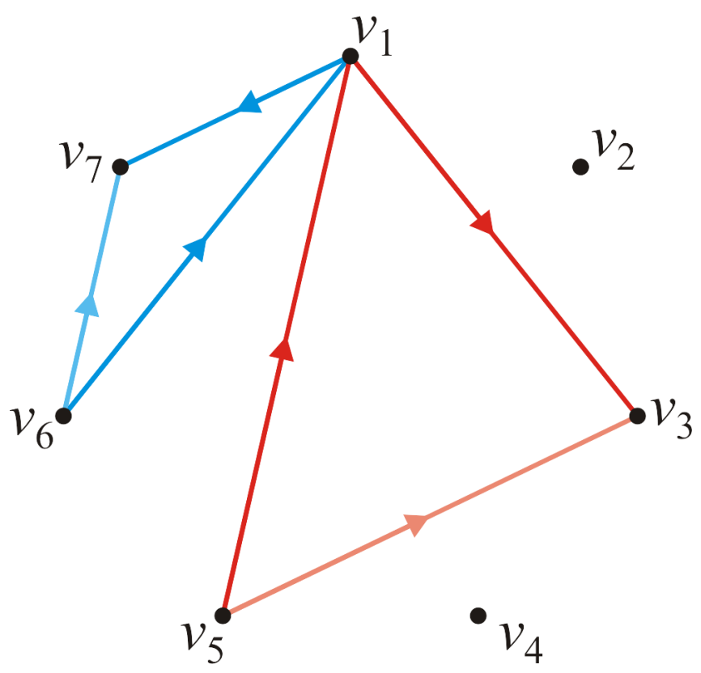
First Iteration
For each pair of vertices, we will define D¹[i,j] by calculating
D¹[i,j] = min (D⁰[i,j], D⁰[i,1] + D⁰[1,j])
for ( int i = 0; i < num_vertices; ++i ) {
for ( int j = 0; j < num_vertices; ++j ) {
D[i][j] = std::min( D[i][j], D[i][0] + D[0][j] );
}
}

Slide 71
First Iteration – Example
1
2
3
1
5
1
0
4
5
4
2
3
D⁰ =
2
2
0
∝
3
∝
-3
0
2
-3
Vertex 1 can be intermediate node
1
2
3
1
0
4
5
D¹[2,3] = min( D⁰[2,3], D⁰[2,1]+D⁰[1,3] )
= min (∝, 7)
= 7
D¹[3,2] = min( D⁰[3,2], D⁰[3,1]+D⁰[1,2] )
= min (-3,∝)
= -3
D¹ =
2
2
0
7
3
∝
-3
0

Slide 72
Second Iteration
With vertex 1 as intermediate we have found the shortest paths from i to j, i to 2 and 2 to j
The only possible shorter path including vertex 2 would be the path from i to 2 continuing from there to j
Thus, calculate
D²[i,j] = min (D¹[i,j], D¹[i,2] + D¹[2,j])

Slide 73
Second Iteration – Example
1
2
3
1
5
1
0
4
5
4
2
3
D¹ =
2
2
0
7
2
-3
3
∝
-3
0
Vertex 1, 2 can be intermediate nodes
1
2
3
D²[1,3] = min( D¹[1,3], D¹[1,2]+D¹[2,3] )
= min (5, 4+7)
= 5
D²[3,1] = min( D¹[3,1], D¹[3,2]+D¹[2,1] )
= min (∝, -3+2)
= -1
1
0
4
5
D² =
2
2
0
7
3
-1
-3
0

Slide 74
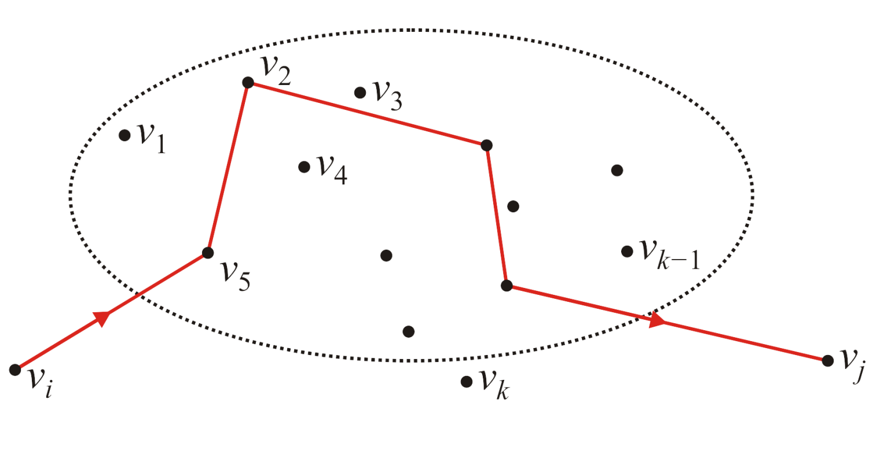
Generalization to K^{th} Iteration
With vertices 1, 2, … k-1 as intermediate we have found the shortest paths from i to j, i to k and k to j
The only possible shorter path including vertex k would be the path from i to k continuing from there to j

Slide 75
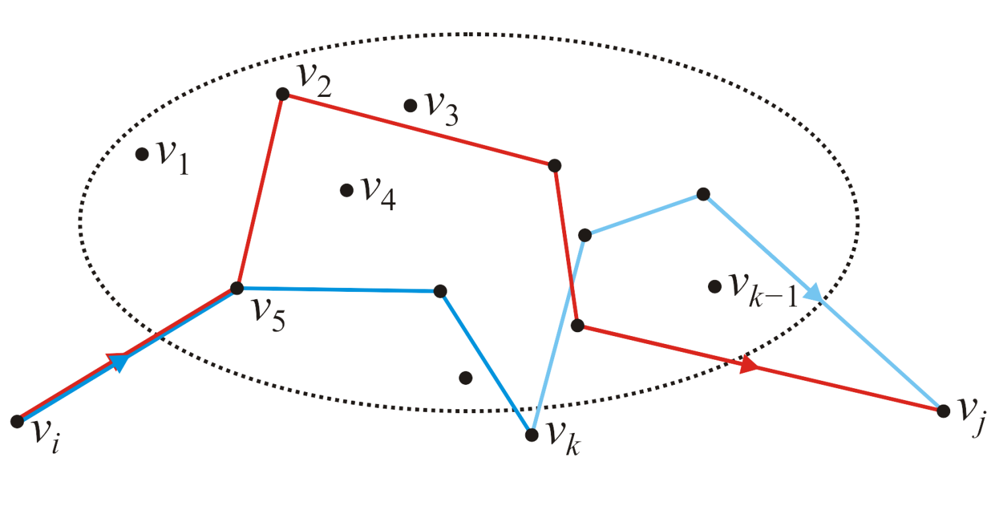
Generalization to K^{th} Iteration
With vertices 1, 2, … k-1 as intermediate we have found the shortest paths from i to j, i to k and k to j
The only possible shorter path including vertex k would be the path from i to k continuing from there to j
Calculate: D^{k}[i,j] = min (D^{k-1}[i,j], D^{k-1}[i,k] + D^{k-1}[k,j])

Slide 76
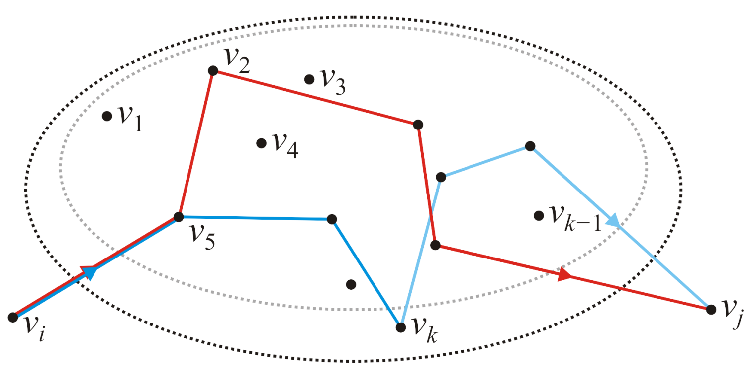
Generalization to K^{th} Iteration
With vertices 1, 2, … k-1 as intermediate we have found the shortest paths from i to j, i to k and k to j
The only possible shorter path including vertex k would be the path from i to k continuing from there to j
Calculate: D^{k}[i,j] = min (D^{k-1}[i,j], D^{k-1}[i,k] + D^{k-1}[k,j])

Slide 77
Floyd’s Algorithm – Pseudocode
double D[num_vertices][num_vertices];
// Initialize the matrix d
// ...
// Run Floyd-Algorithm
for ( int k = 0; k < num_vertices; ++k ) {
for ( int i = 0; i < num_vertices; ++i ) {
for ( int j = 0; j < num_vertices; ++j ) {
D[i][j] = std::min( D[i][j], D[i][k] + D[k][j] );
}
}
}

Slide 78
Floyd’s Algorithm – Pseudocode
Runtime O(|V|³)
This algorithm finds the shortest distances, but what are the paths corresponding to those shortest distances?
double D[num_vertices][num_vertices];
// Initialize the matrix d
// ...
// Run Floyd-Algorithm
for ( int k = 0; k < num_vertices; ++k ) {
for ( int i = 0; i < num_vertices; ++i ) {
for ( int j = 0; j < num_vertices; ++j ) {
D[i][j] = std::min( D[i][j], D[i][k] + D[k][j] );
}
}
}
if( D[i][j] > D[i][k] + D[k][j] ){
D[i][j] = D[i][k] + D[k][j];
}

Slide 79
Tracking Shortest Paths
Use another matrix P
P[i,j] holds the vertex k that led to the smallest value of D[i,j]
If P[i,j]=0 there is no intermediate edge involved
Shortest path is direct edge between i and j
// Run Floyd-Algorithm
for ( int k = 0; k < num_vertices; ++k ) {
for ( int i = 0; i < num_vertices; ++i ) {
for ( int j = 0; j < num_vertices; ++j ) {
if( D[i][j] > D[i][k] + D[k][j] ){
D[i][j] = D[i][k] + D[k][j];
P[i][j] = k;
}
}
}
}

Slide 80
Floyd’s Algorithm – Example Revisited
1
2
3
1
5
1
0
4
5
4
2
3
W = D⁰ =
2
2
0
∝
3
∝
-3
0
2
-3
1
2
3
1
0
0
0
P =
2
0
0
0
3
0
0
0

Slide 81
Floyd’s Algorithm – Example Revisited
1
2
3
1
5
1
0
4
5
4
2
3
D⁰ =
2
2
0
∝
3
∝
-3
0
2
-3
1
2
3
Vertex 1 can be intermediate node
1
0
4
5
D¹ =
D¹[2,3] = min( D⁰[2,3], D⁰[2,1]+D⁰[1,3] )
= min (∝, 7)
= 7
D¹[3,2] = min( D⁰[3,2], D⁰[3,1]+D⁰[1,2] )
= min (-3,∝)
= -3
2
2
0
7
3
∝
-3
0
1
2
3
1
0
0
0
P =
2
0
0
1
3
0
0
0

Slide 82
Floyd’s Algorithm – Example Revisited
1
2
3
1
5
1
0
4
5
4
2
3
D¹ =
2
2
0
7
2
-3
3
∝
-3
0
1
2
3
Vertex 1, 2 can be intermediate nodes
1
0
4
5
D²[1,3] = min( D¹[1,3], D¹[1,2]+D¹[2,3] )
= min (5, 4+7)
= 5
D²[3,1] = min( D¹[3,1], D¹[3,2]+D¹[2,1] )
= min (∝, -3+2)
= -1
D² =
2
2
0
7
3
-1
-3
0
1
2
3
1
0
0
0
P =
2
0
0
1
3
2
0
0

Slide 83
Floyd’s Algorithm – Example Revisited
1
2
3
1
5
1
0
4
5
4
2
3
D² =
2
2
0
7
2
-3
3
-1
-3
0
1
2
3
Vertex 1, 2, 3 can be intermediate nodes
1
0
2
5
D³ =
D³[1,2] = min(D²[1,2], D²[1,3]+D²[3,2] )
= min (4, 5+(-3))
= 2
D³[2,1] = min(D²[2,1], D²[2,3]+D²[3,1] )
= min (2, 7+ (-1))
= 2
2
2
0
7
3
-1
-3
0
1
2
3
1
0
3
0
P =
2
0
0
1
3
2
0
0

Slide 84
Printing Intermediate Vertices
To print the intermediate nodes on shortest path from vertex i to j
Path (i, j)
{
k= P[ i, j ];
if (k == 0) {
return;
}
Path (i , k);
print( k);
Path (k, j);
}
1
5
4
2
3
2
-3
1
2
3
1
0
3
0
P =
2
0
0
1
3
2
0
0

Slide 85
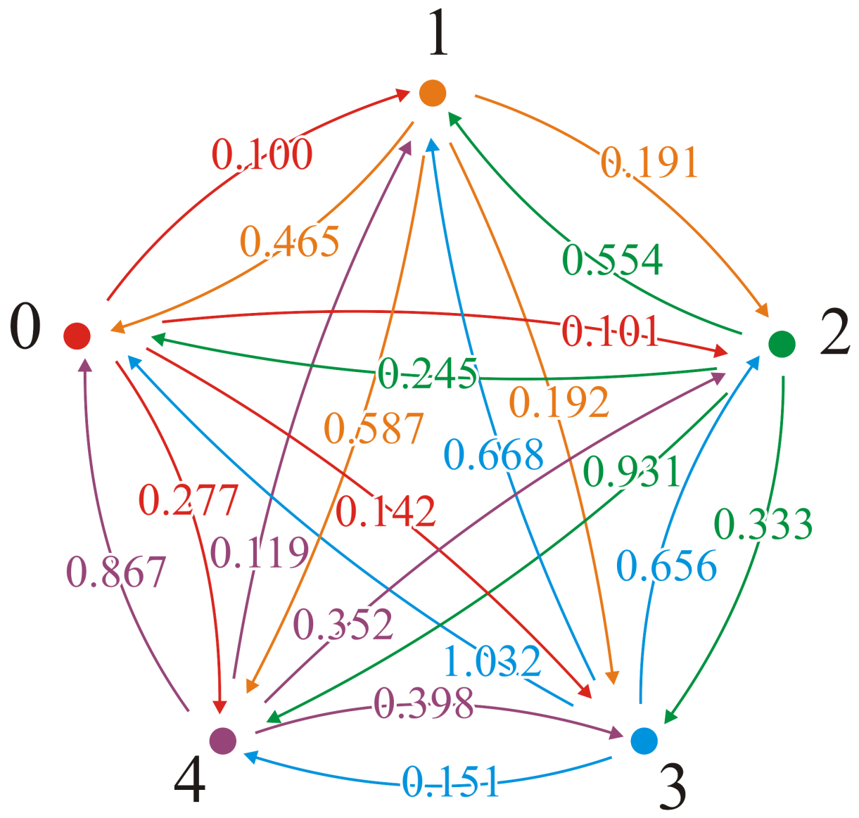
Floyd’s Algorithm – Another Example
The D⁰ matrix
2
1
3
5
4

Slide 86

Floyd’s Algorithm – Another Example
First attempt passing through vertex 1
We can check: (2, 3) → (2, 1, 3)
0.191 ≯ 0.465 + 0.101

Slide 87
Floyd’s Algorithm – Another Example
First attempt passing through vertex 1
We can check: (2, 4) → (2, 1, 4)
0.192 ≯ 0.465 + 0.142

Slide 88
Floyd’s Algorithm – Another Example
First attempt passing through vertex 1
We can check: (2, 5) → (2, 1, 5)
0.587 ≯ 0.465 + 0.277

Slide 89
Floyd’s Algorithm – Another Example
First attempt passing through vertex 1
Here is a shorter path: (3, 2) → (3, 1, 2)
0.554 > 0.245 + 0.100 = 0.345

Slide 90
Floyd’s Algorithm – Another Example
First attempt passing through vertex 1
Here is a shorter path: (3, 2) → (3, 1, 2)
0.554 > 0.245 + 0.100 = 0.345
We can update matrix!

Slide 91
Floyd’s Algorithm – Another Example
First attempt passing through vertex 1
We can check: (3, 4) → (3, 1, 4)
0.333 ≯ 0.245 + 0.142

Slide 92
Floyd’s Algorithm – Another Example
First attempt passing through vertex 1
Another shorter path: (3, 5) → (3, 1, 5)
0.931 > 0.245 + 0.277 = 0.522

Slide 93
Floyd’s Algorithm – Another Example
First attempt passing through vertex 1
Another shorter path: (3, 5) → (3, 1, 5)
0.931 > 0.245 + 0.277 = 0.522
We can update matrix!

Slide 94
Floyd’s Algorithm – Another Example
First attempt passing through vertex 1
Continuing: (4, 2) → (4, 1, 2)
0.668 ≯ 1.032 + 0.100
In fact, no other shorter paths through vertex 1 exist!

Slide 95
Floyd’s Algorithm – Another Example
The D⁰ matrix
2
1
3
The D¹ matrix
5
4

Slide 96
Floyd’s Algorithm – Another Example
Now attempt passing through vertex 2
There are three shorter paths: (5, 1) → (5, 2, 1)
0.867 > 0.119 + 0.465 = 0.584
(5, 3) → (5, 2, 3)
0.352 > 0.119 + 0.191 = 0.310
(5, 4) → (5, 2, 4)
0.398 > 0.119 + 0.192 = 0.311

Slide 97
Floyd’s Algorithm – Another Example
Now attempt passing through vertex 2
We can update matrix to get D²

Slide 98
Floyd’s Algorithm – Another Example
Now attempt passing through vertex 3
There are three shorter paths: (2, 1) → (2, 3, 1)
0.465 > 0.191 + 0.245 = 0.436
(4, 1) → (4, 3, 1)
1.032 > 0.656 + 0.245 = 0.901
(5, 1) → (5, 3, 1)
0.584 > 0.310 + 0.245 = 0.555

Slide 99
Floyd’s Algorithm – Another Example
Now attempt passing through vertex 3
We can update matrix to get D³

Slide 100
Floyd’s Algorithm – Another Example
Now attempt passing through vertex 4
There are two shorter paths: (2, 5) → (2, 4, 5)
0.587 > 0.192 + 0.151
(3, 5) → (3, 4, 5)
0.522 > 0.333 + 0.151

Slide 101
Floyd’s Algorithm – Another Example
Now attempt passing through vertex 4
We can update matrix to get D⁴

Slide 102
Floyd’s Algorithm – Another Example
Now attempt passing through vertex 5
There are two shorter paths: (4, 1) → (4, 5, 1)
0.901 > 0.151 + 0.555 = 0.706
(4, 2) → (4, 5, 2)
0.668 > 0.151 + 0.119 = 0.270
(4, 3) → (4, 5, 3)
0.656 > 0.151 + 0.310 = 0.461

Slide 103
Floyd’s Algorithm – Another Example
Now attempt passing through vertex 5
We can update matrix to get D⁵
Thus, we have all pairs shortest paths

Slide 104
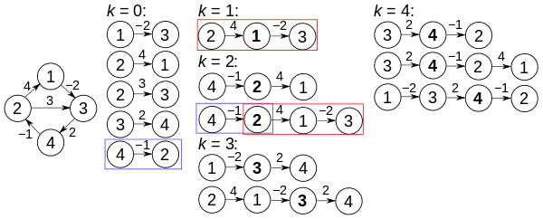
All Pairs Shortest Paths – Yet Another Example

Slide 105
Any Question So Far?

Slide 106
Quiz – Sec A (03 Dec 2019)
Find the shortest path from A to all other vertices
Construct the shortest path tree rooted at A
5
B
D
10
A
1
8
4
7
1
3
C
E
2

Slide 107
Quiz – Sec C
Find the shortest path from B to all other vertices
Construct the shortest path tree rooted at B
5
B
D
10
A
1
8
4
7
1
3
C
E
2

Slide 108
Quiz – Sec B (26 Nov 2016)
Find the shortest path from B to all other vertices
Construct the shortest path tree rooted at B
2
B
D
10
A
1
8
4
7
9
3
C
E
2

